Slide 1



Slide 2
Modern E-Learning Platform
2025
Solely making in PHP & MySQL

Slide 3
Group Details
2025
Student ID: BC190203051
Name: Umair Maqbool
Role: Both Front & Backend Developer
Group ID: F24PROJECTD409E
Supervisor: Amjad Iqbal Khan
Umair Maqbool independently developed the entire project using PHP, handling both frontend and backend tasks. He is a Software Engineering student at Virtual University with a strong interest in Frontend & Backend web development and always strive to explore new languages in the industry.

Slide 4

Introduction of the Project
2025
Modern E-Learning Platform
The Modern E-Learning Platform is a PHP-based system built to meet the growing demand for online education. It will help create and manage courses, deliver high-quality content, and ensure an interactive, personalized learning experience. Key features include course catalogs, multimedia support, progress tracking, and certifications.

Slide 5
Introduction of the Project
2025
Modern E-Learning Platform
The platform will be developed using PHP for its flexibility, ease of use, and ability to integrate with various systems. PHP’s strong backend will handle content management, user authentication, and secure transactions. This platform will provide a scalable, accessible solution that ensures smooth performance and a great user experience.

Slide 6
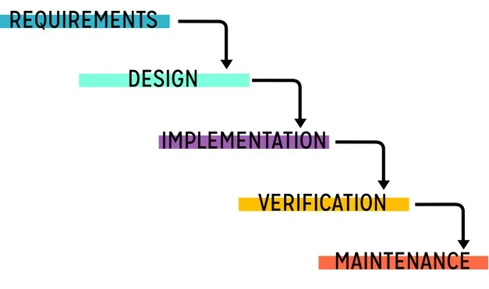
Adopted Methodology:
2025
VU Process Model

Slide 7
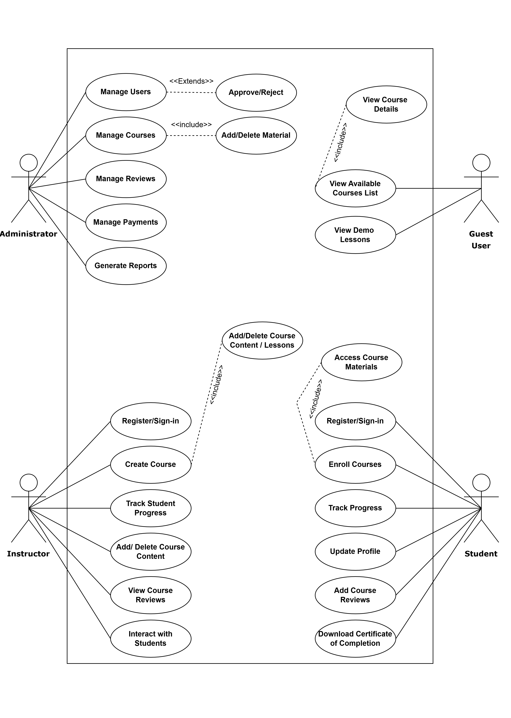
Use Case Diagram
2025

Slide 8
Business Rules Catalog:
20XX
User Authentication and Authorization: User registration and login for students, instructors, and admins. & Role-based access control to restrict access to features.
Course Management: Course creation, editing, and deletion by instructors and admins.
Student’s Enrollment: Students can enroll in free or paid courses. I’ve used manual enrollment process and approval system. Track student progress across courses.
Lesson and Content Delivery: Interactive lessons with video resources.
Course Reviews: Students can rate and leave reviews for completed courses. Instructors/Administrator can view feedback to improve courses.
Instructor Dashboard: Instructors can create and manage courses , View and track student progress and course completion rates.
Admin Dashboard: Admins can manage users (students, instructors). Keep or delete courses.
Mobile-Friendly Design: Fully responsive design to ensure usability across mobile and tablet devices.
Search Functionality: Search and filter options for finding courses, lessons, or instructors based on keywords or categories.

Slide 9
Architecture Design Diagram
2025
Users (Students, Instructors, Admins)
Interface / Forms (Web & Mobile)
Business Logic (Course Management, Enrollments, Payments, Reviews)
Data Access Component (API & Database Communication)
SQL Server Database

Slide 10
Team Structure
2025
Roles:
Project Management: Planned timeline, milestones, task ownership, and documentation.
Frontend & Backend Development: Designed responsive GUI using modern UI frameworks, implemented server logics, session handling and core functionalities.
Database Design: Structured schema, created ERD and managed SQL scripts.
UI/UX Design: Developed User-friendly flows with emphasis on clarity and aesthetics.
Testing & Debugging: Conducted functional testing, resolved bugs, and validated logics.
Solo: Full Stack Developer Project
Umair Maqbool independently developed the entire project using PHP, handling both frontend and backend tasks. He is a Software Engineering student at Virtual University with a strong interest in Frontend & Backend web development and always strive to explore new languages in the industry.

Slide 11
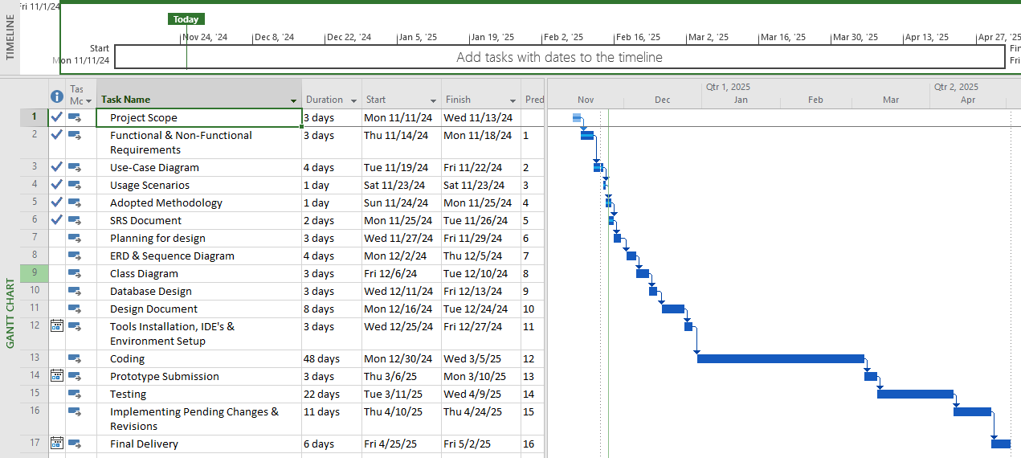
Project Schedule/Gantt Chart:
2025

Slide 12
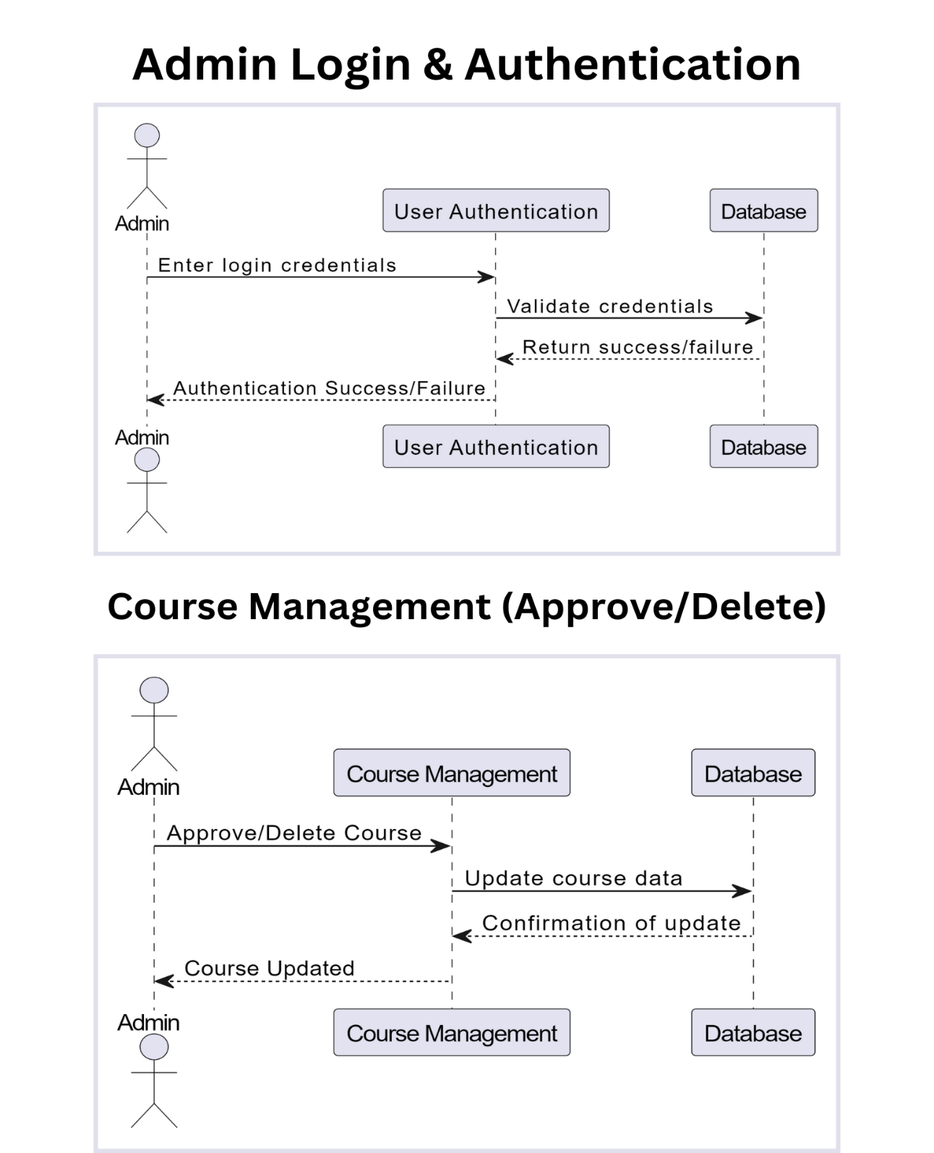
Sequence Diagrams:
2025
Admin Role Diagram

Slide 13
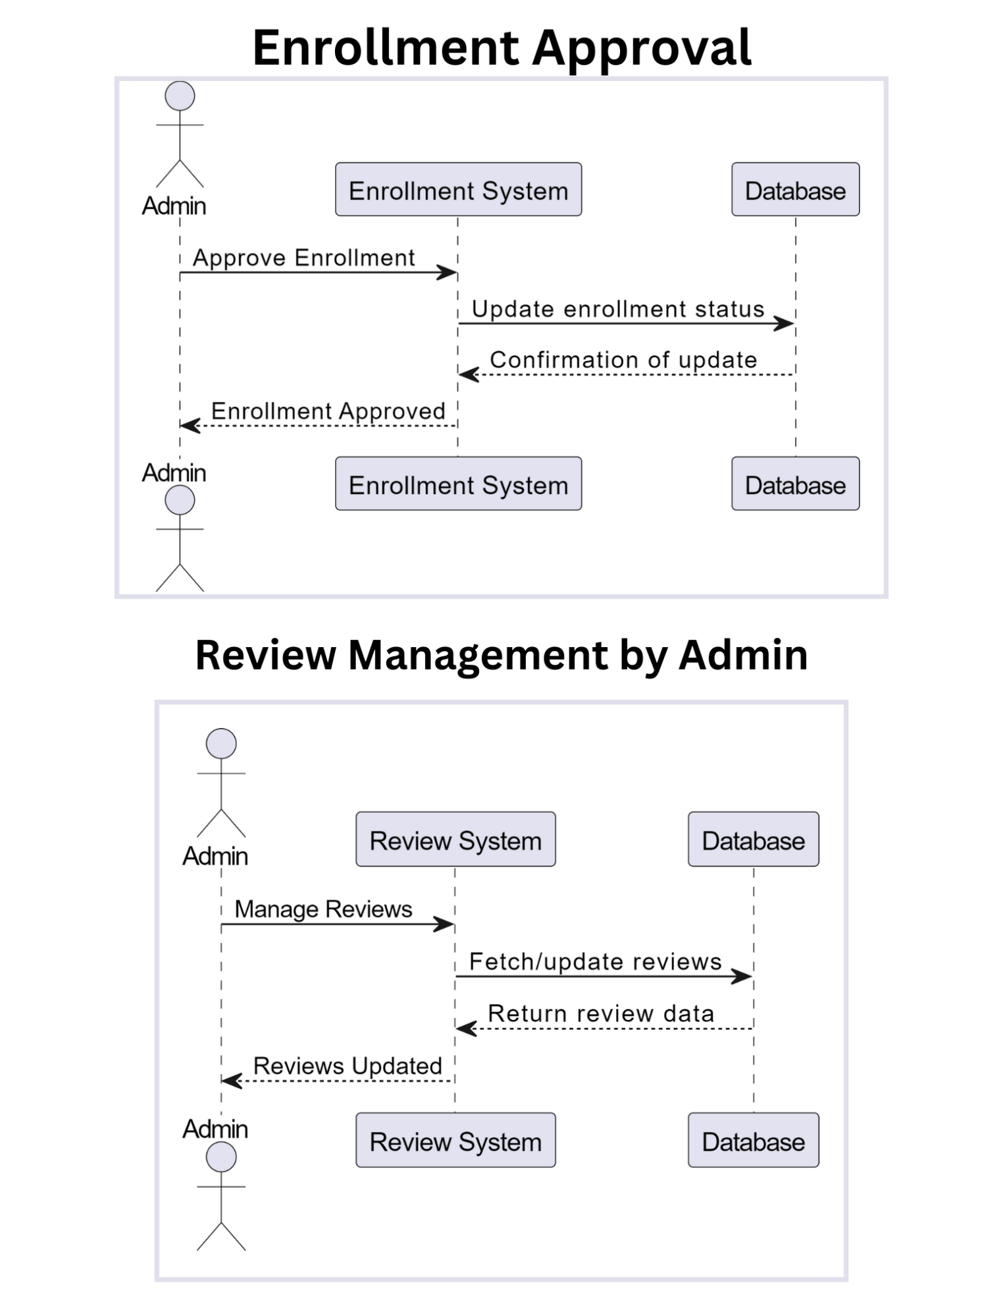
Sequence Diagrams:
2025
Admin Role Diagram

Slide 14
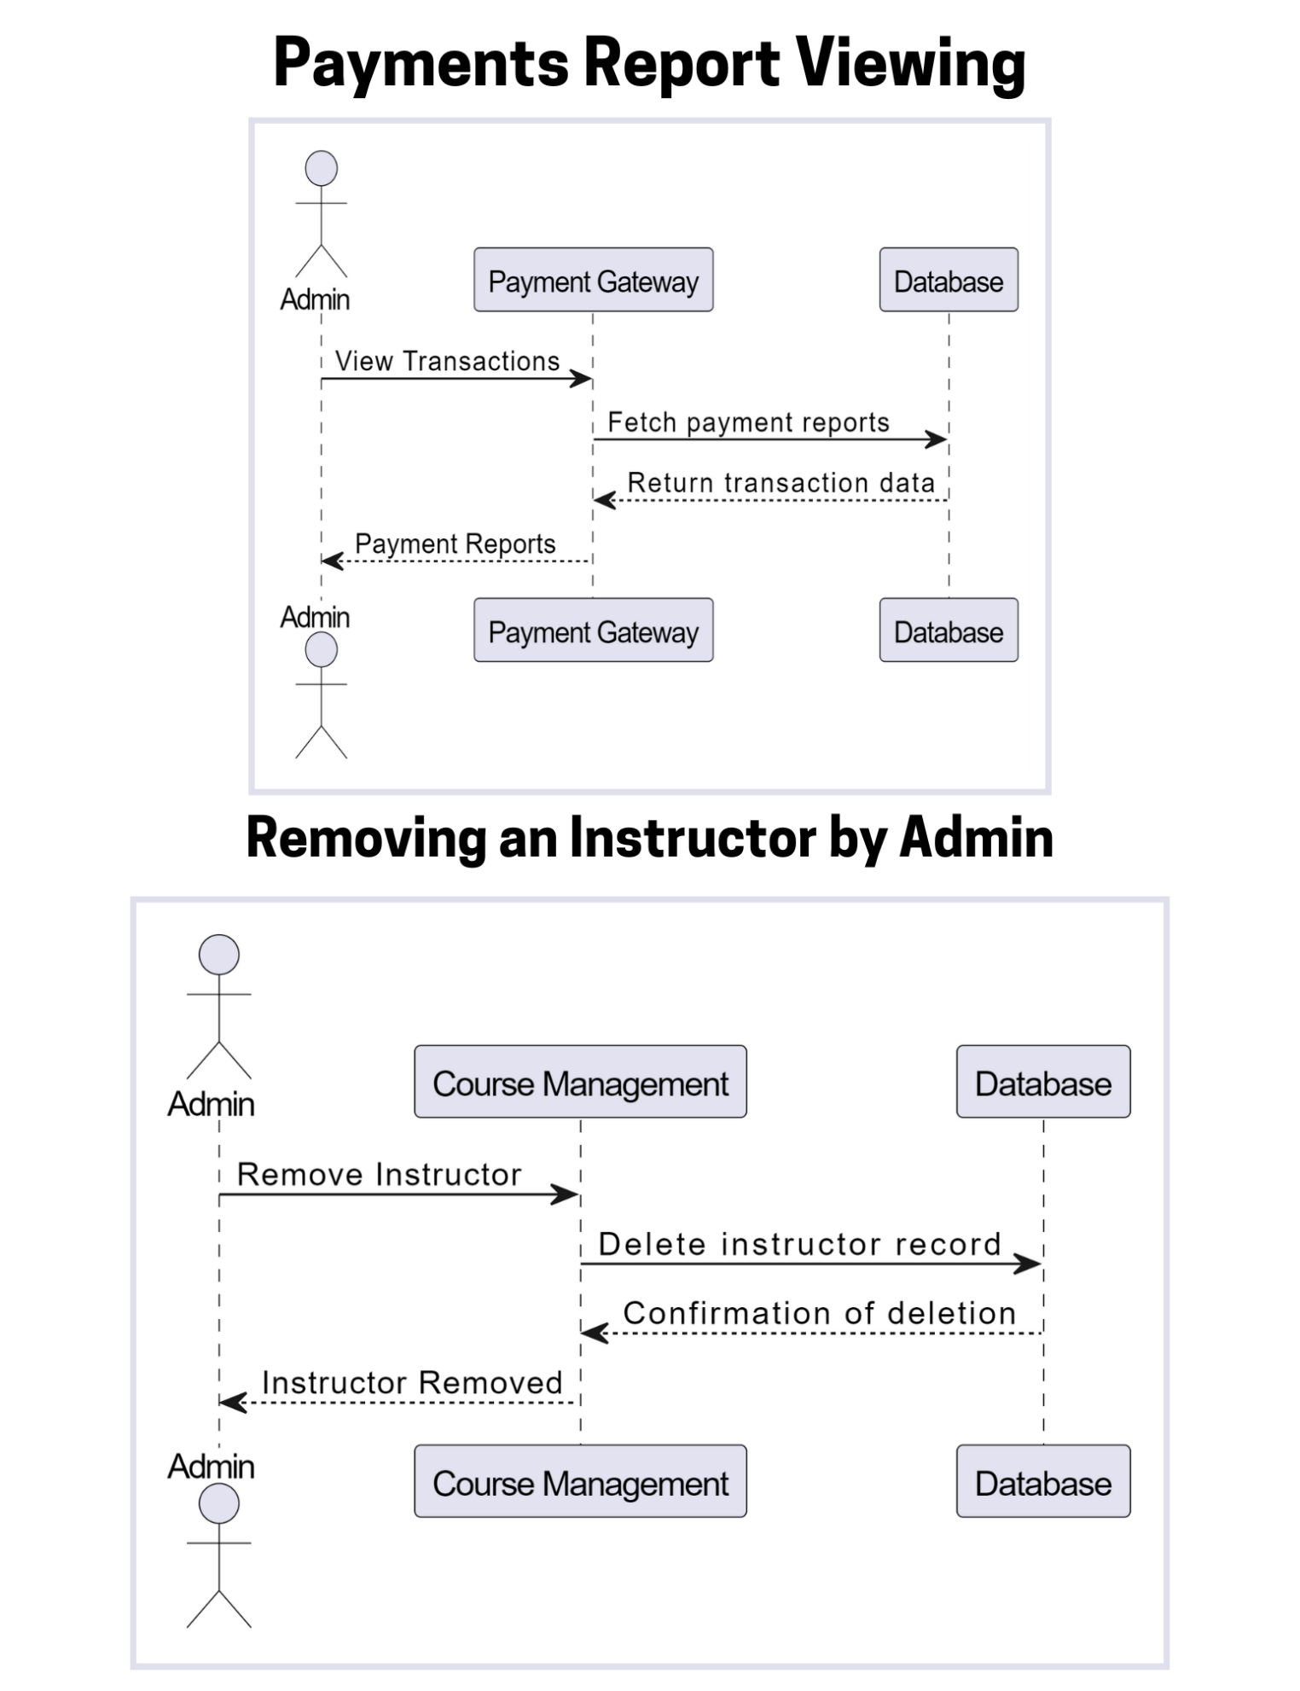
Sequence Diagrams:
2025
Admin Role Diagram

Slide 15
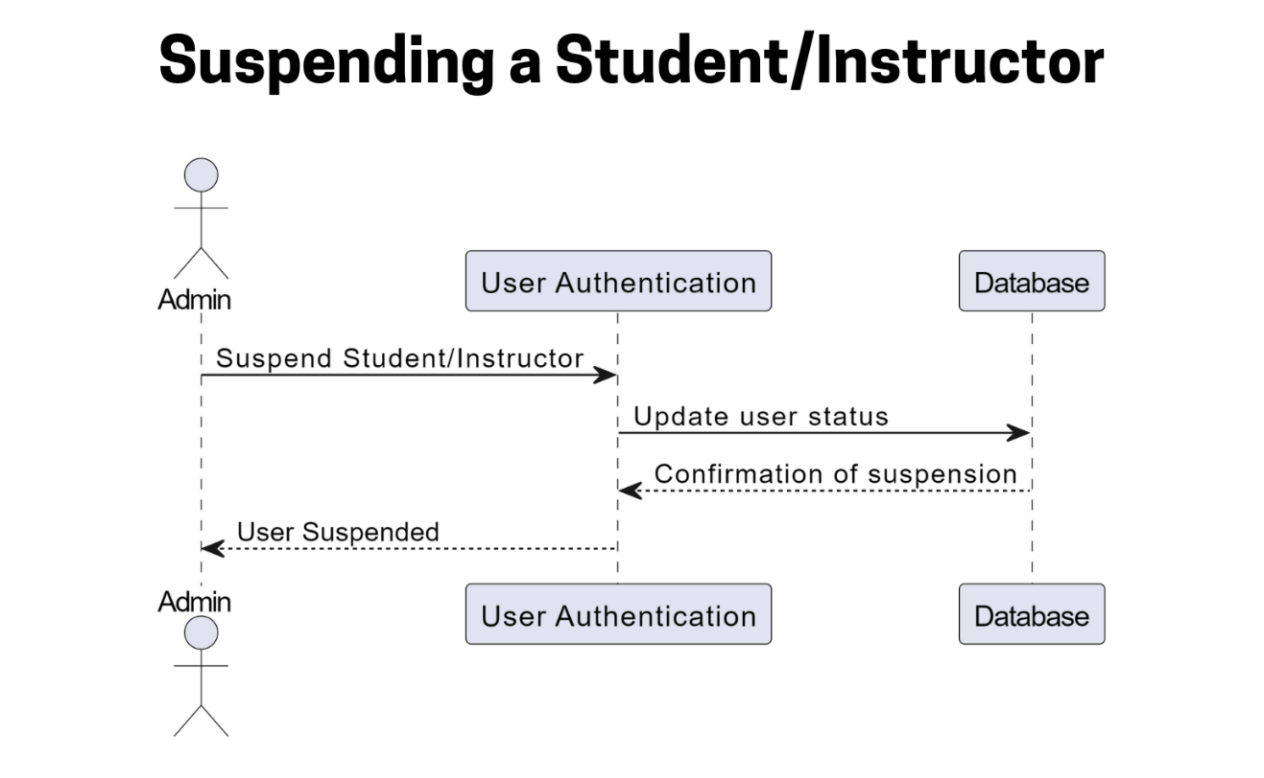
Sequence Diagrams:
2025
Admin Role Diagram

Slide 16
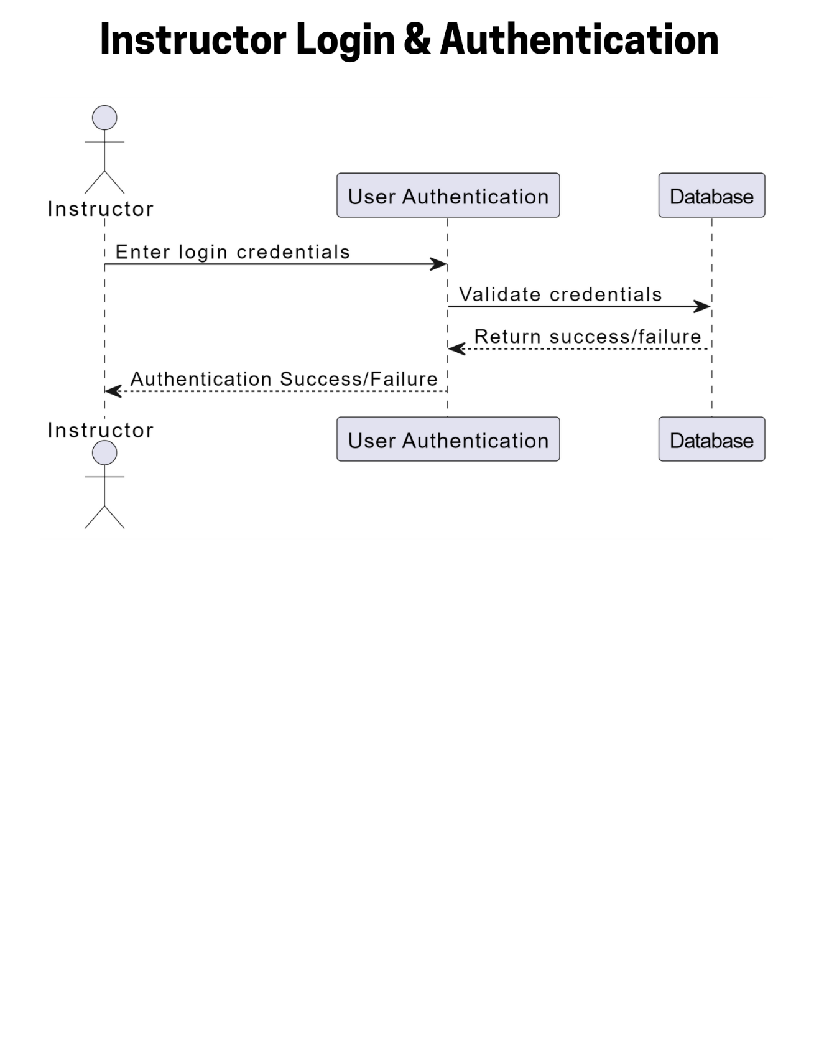
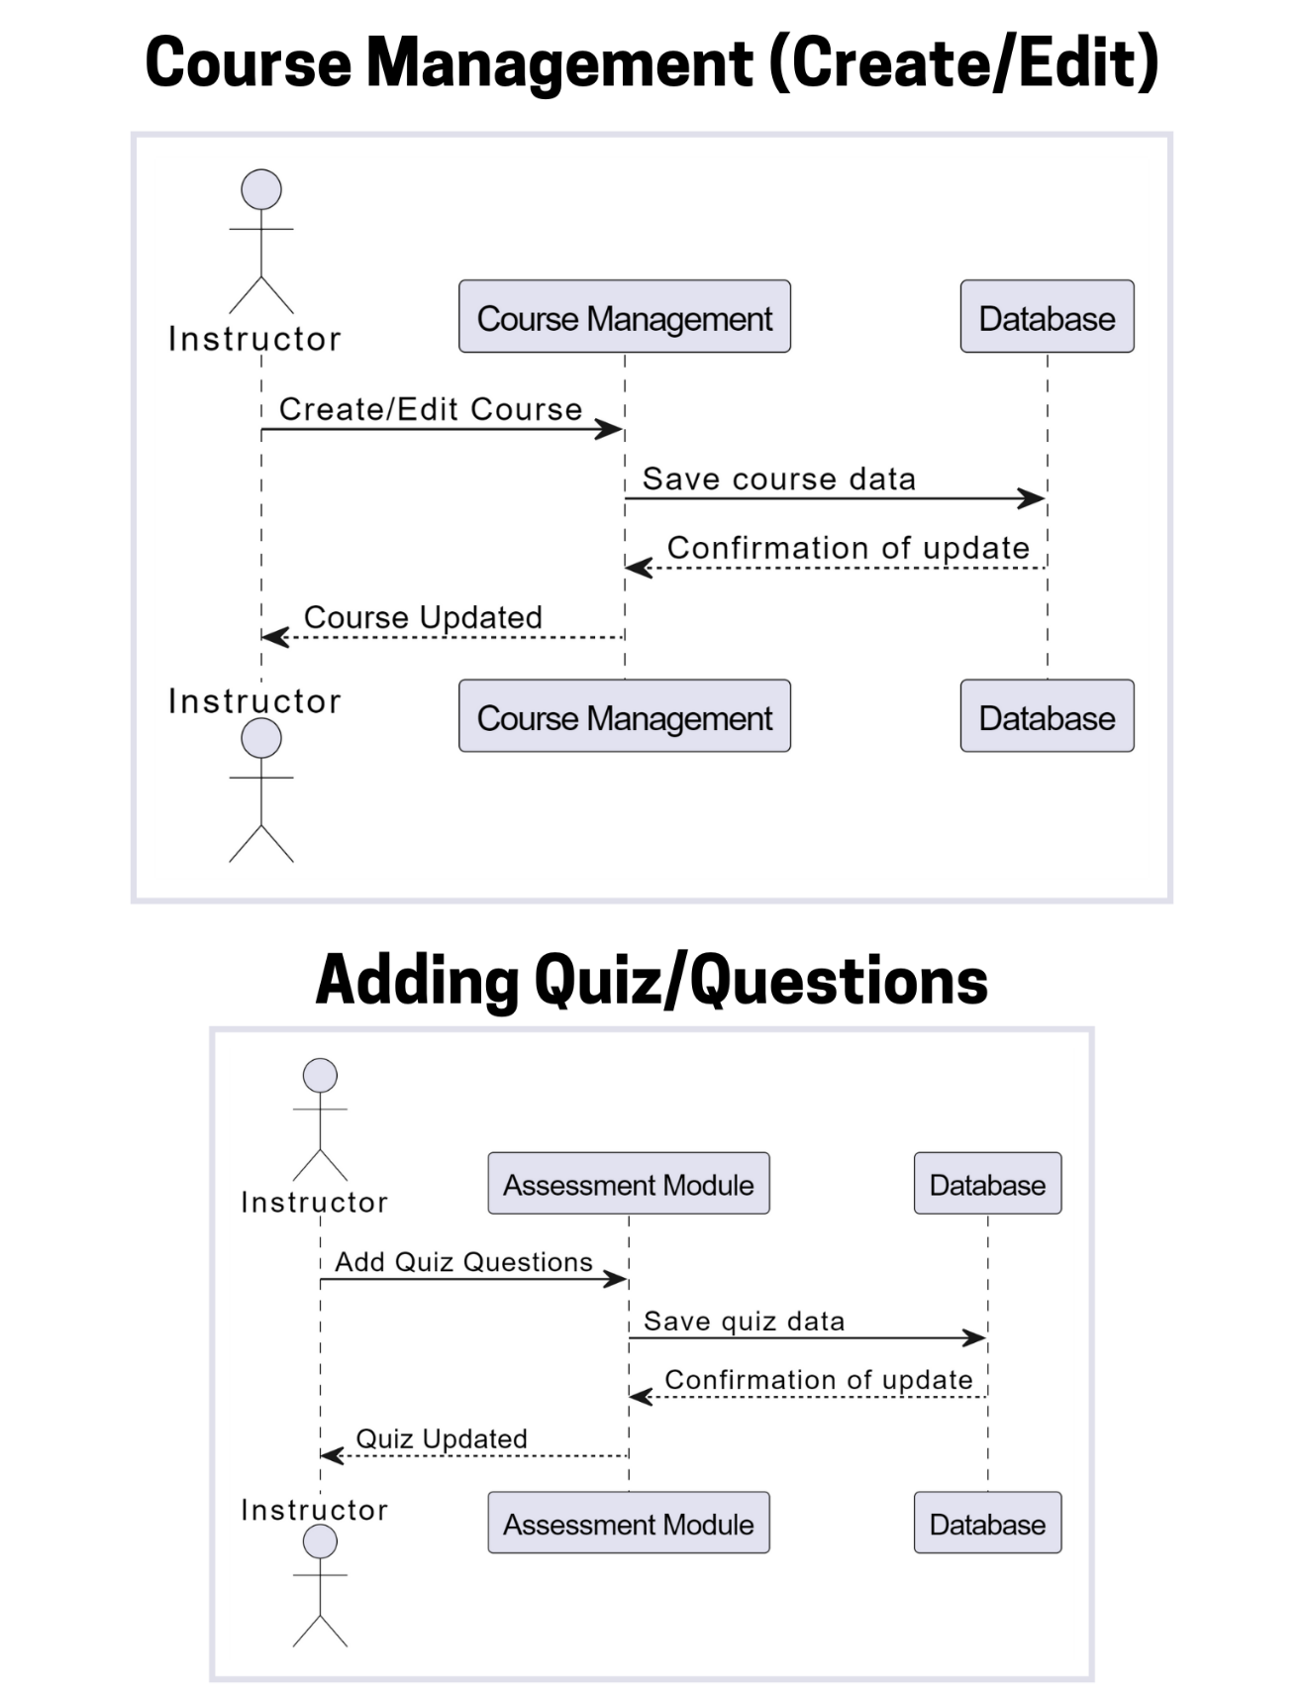
Sequence Diagrams:
2025
Instructor Role Diagram

Slide 17
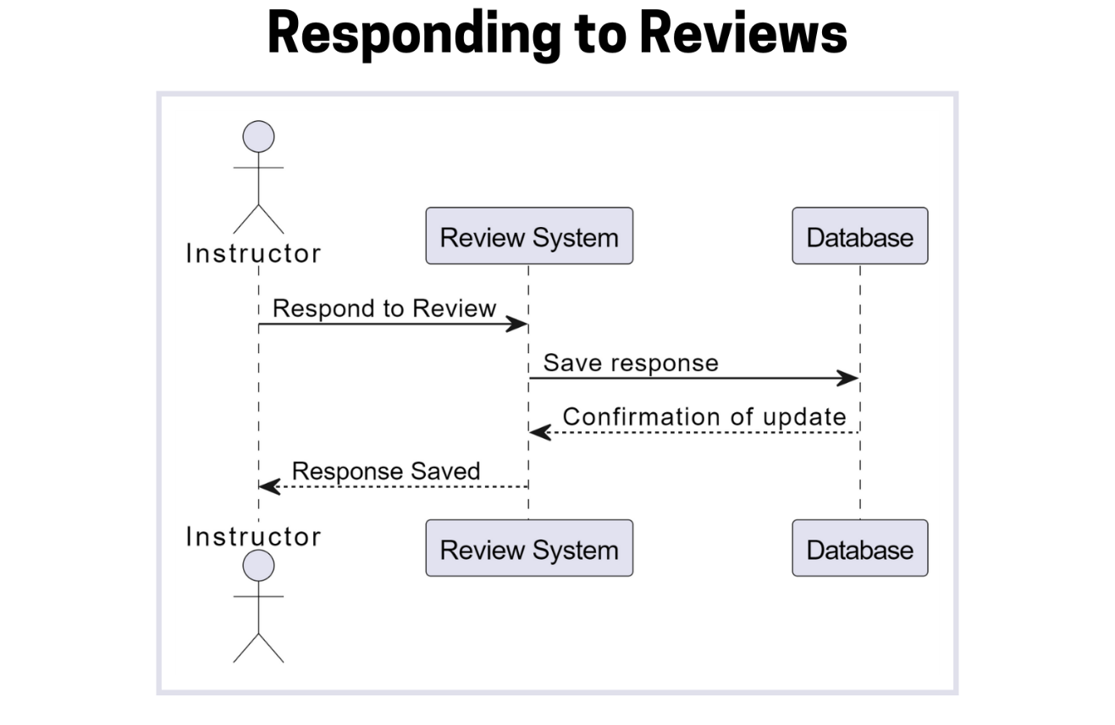
Sequence Diagrams:
2025
Instructor Role Diagram

Slide 18
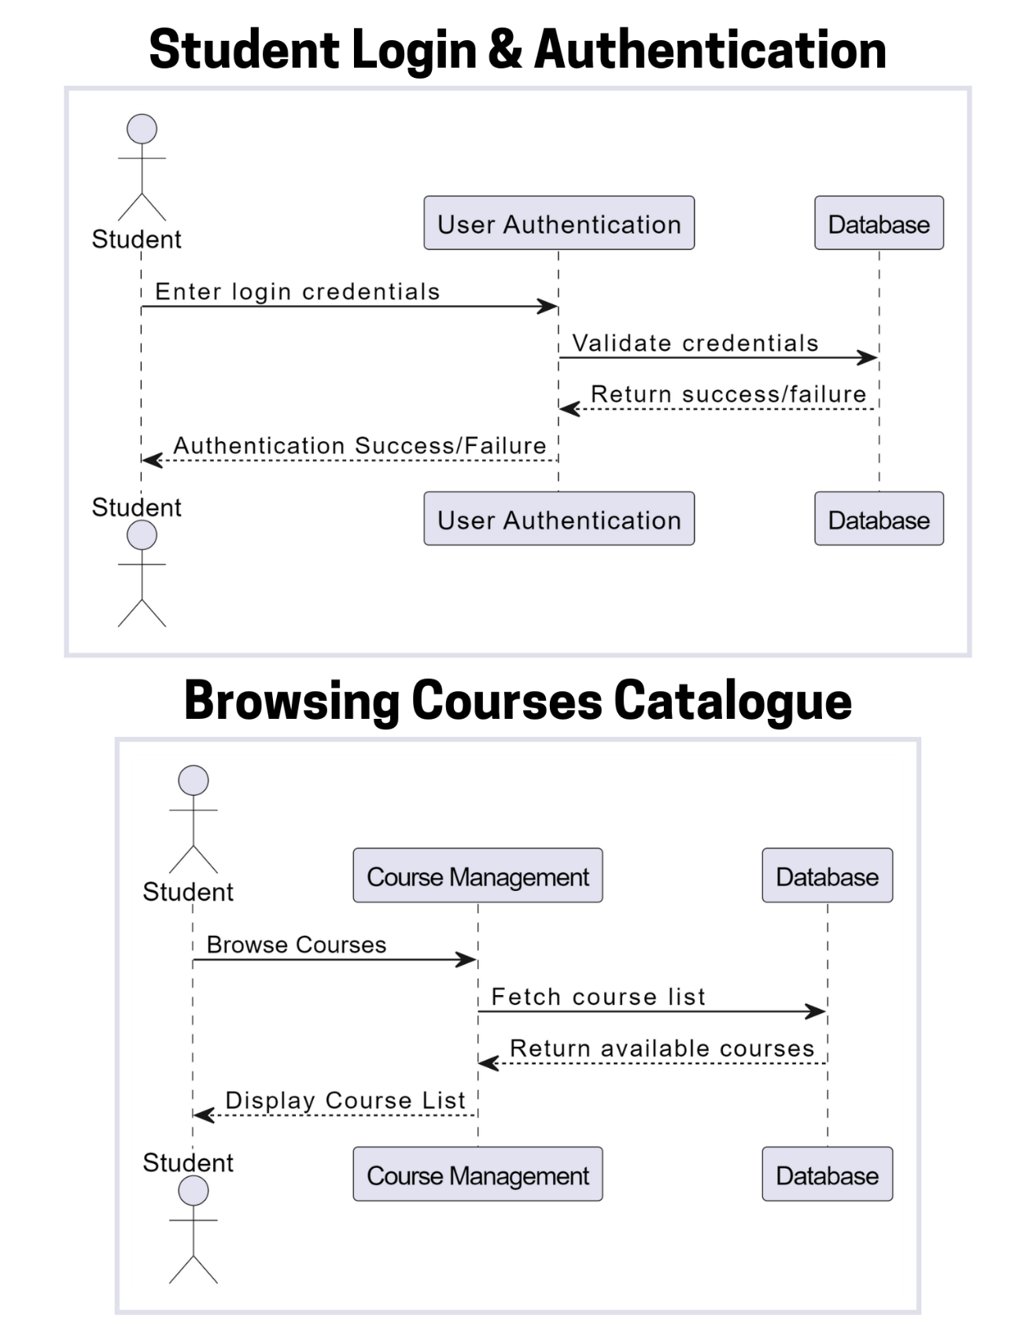
Sequence Diagrams:
2025
Student Role Diagram

Slide 19
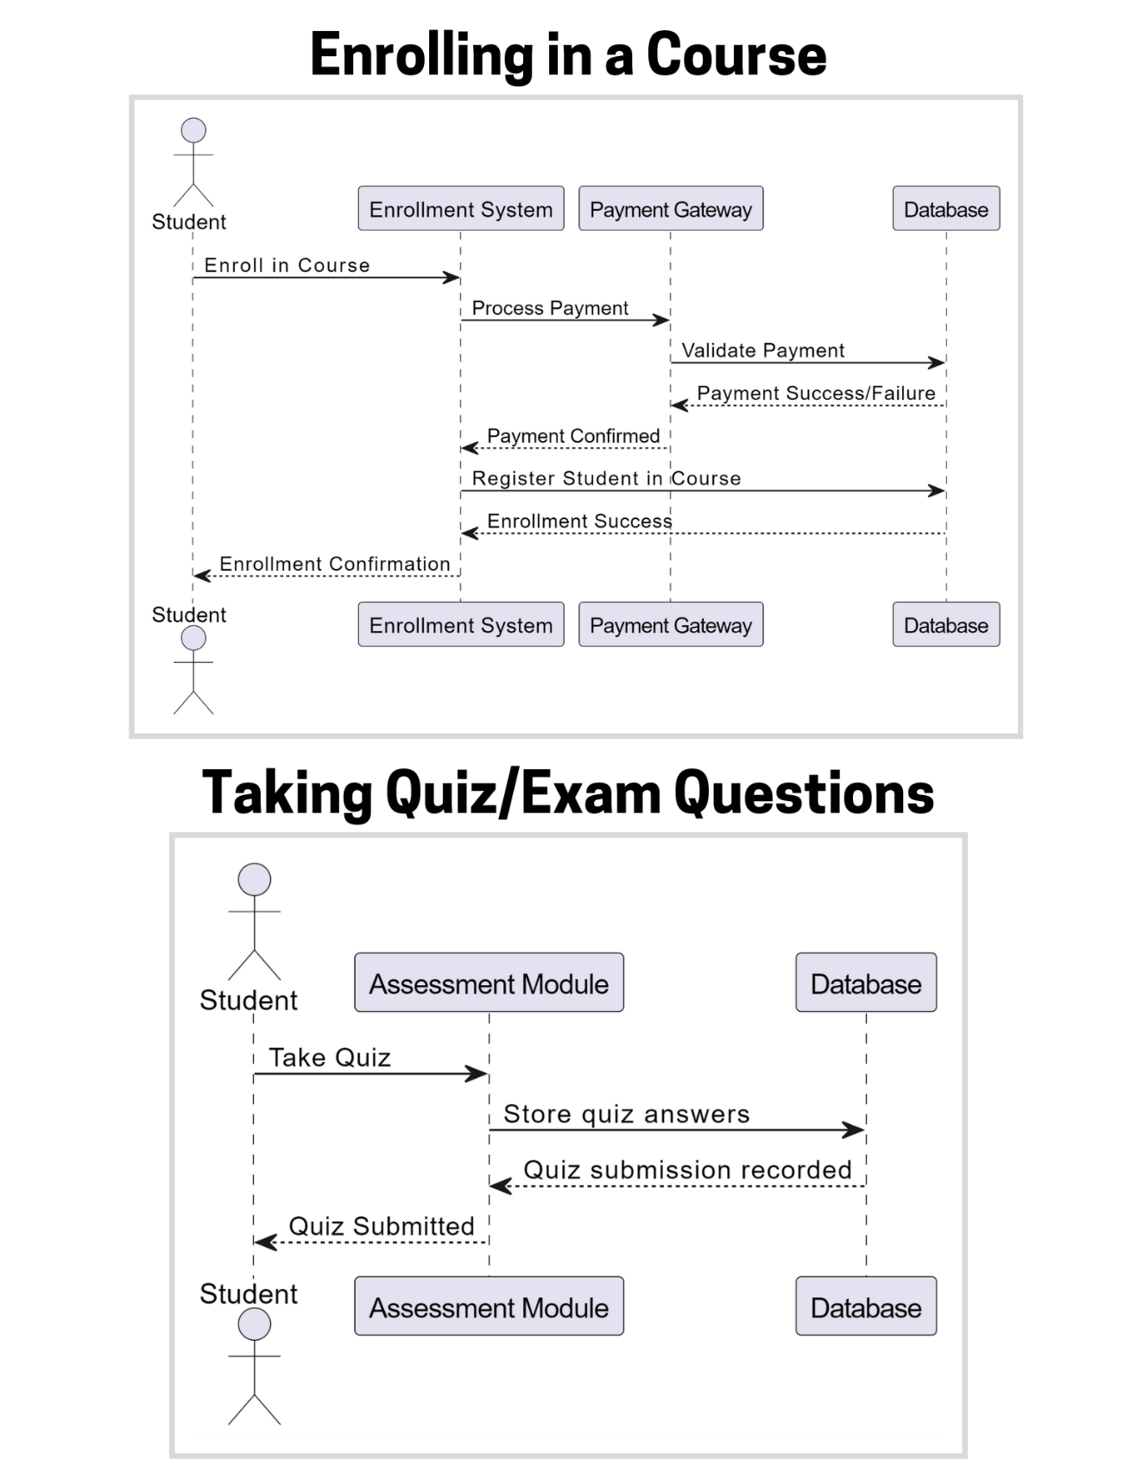
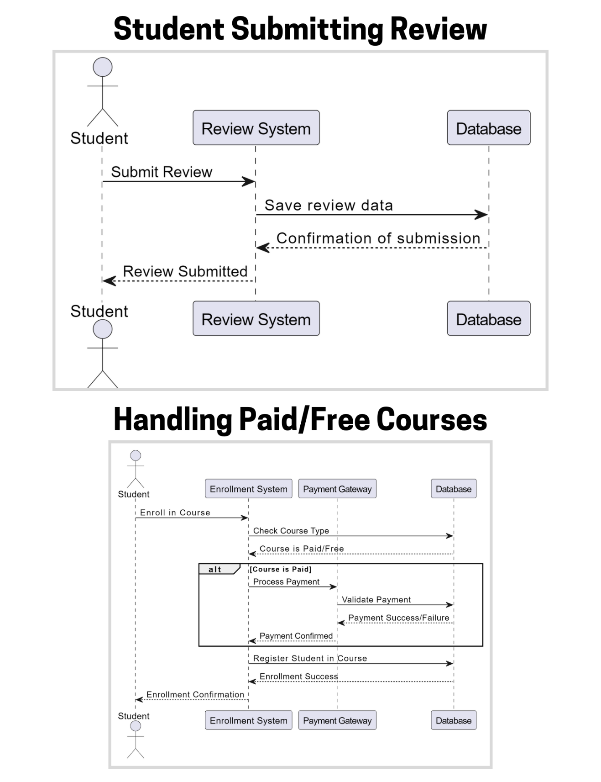
Sequence Diagrams:
2025
Student Role Diagram

Slide 20
Sequence Diagrams:
2025
Student Role Diagram

Slide 21
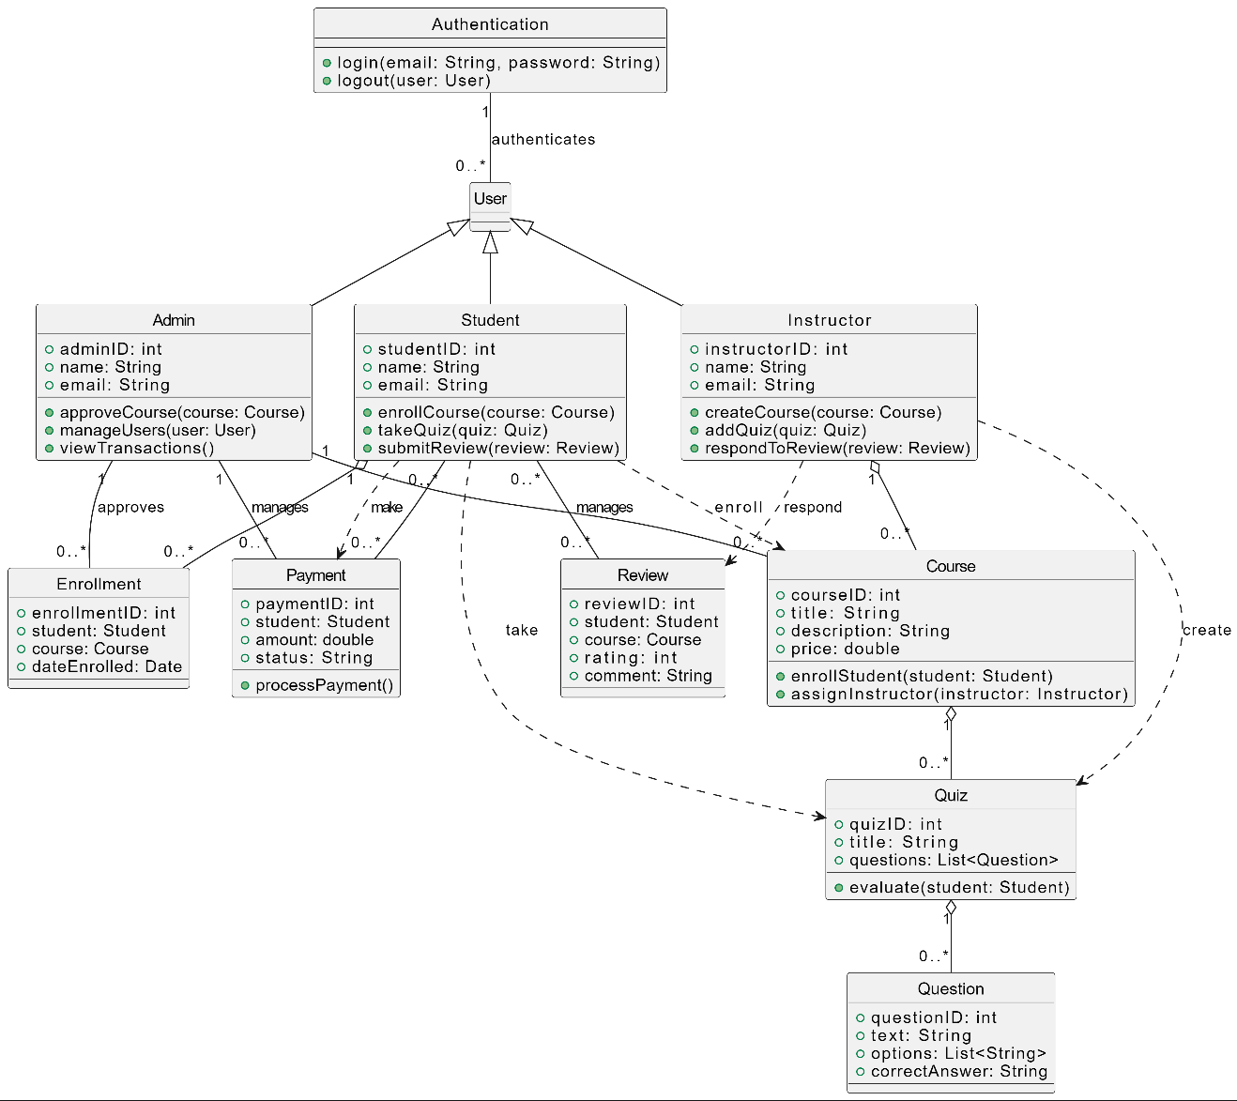
Logical Model / Class Diagram
2025

Slide 22
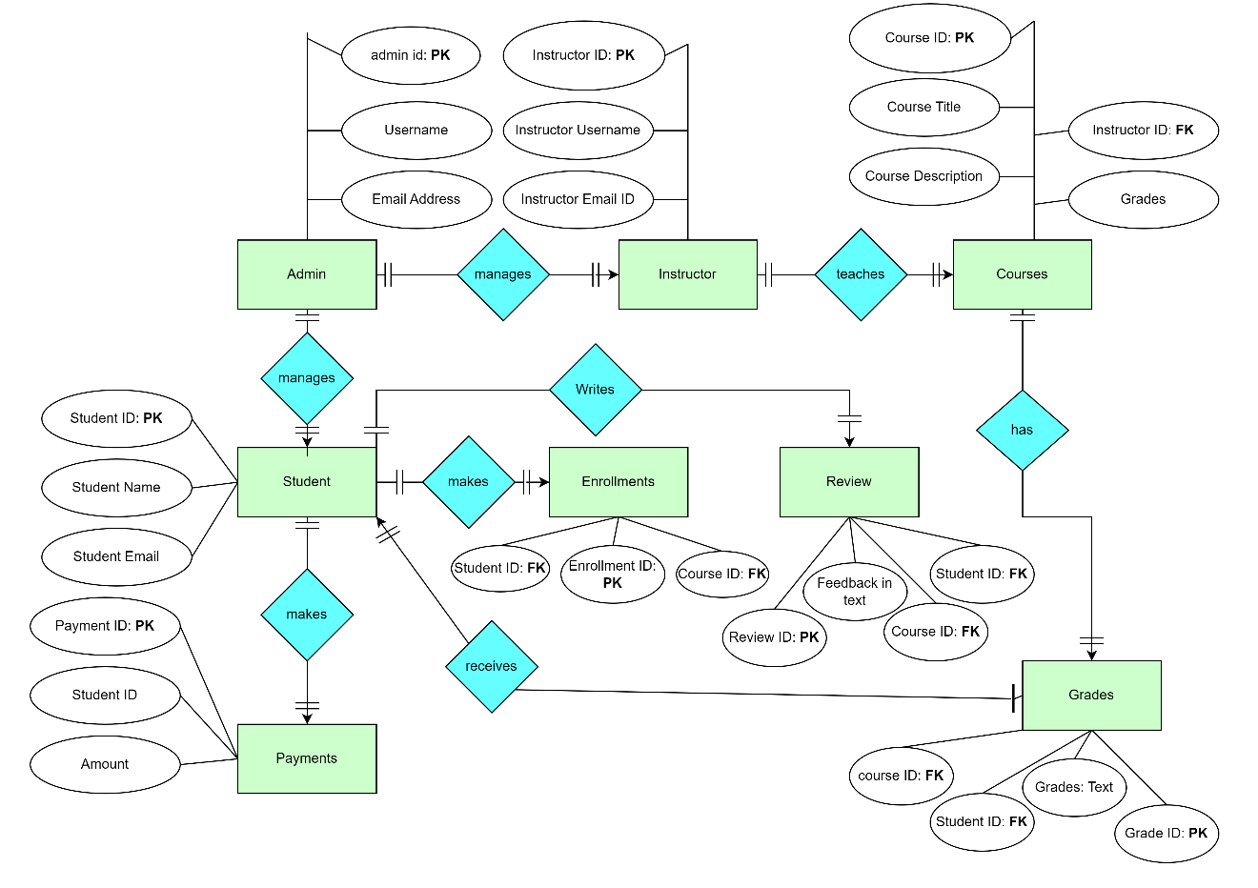
ERD – Entity Relationship Diagram
2025

Slide 23
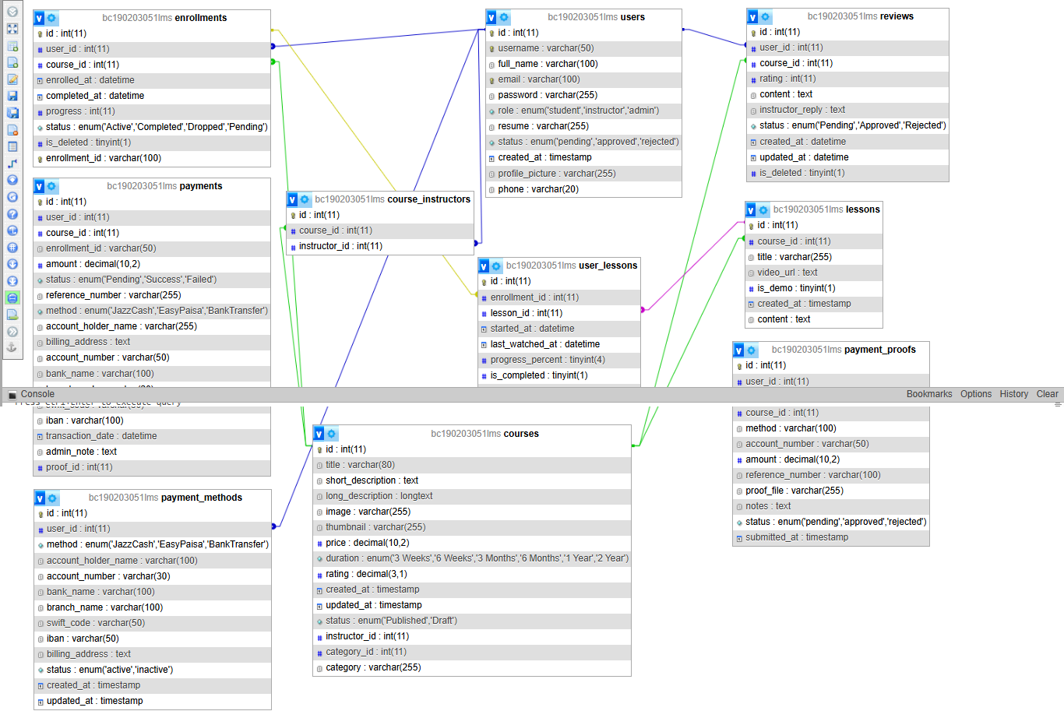
Database Design
2025

Slide 24
User-Interfaces
2025
Global Header for Guest & Logged Out Users
Role Based Header for Logged in Users

Slide 25

User-Interfaces
2025
Main GUI Home page
Hero Section of Page
Platform Features Cards
All Published Courses Real time Shows Here
Footer Section

Slide 26
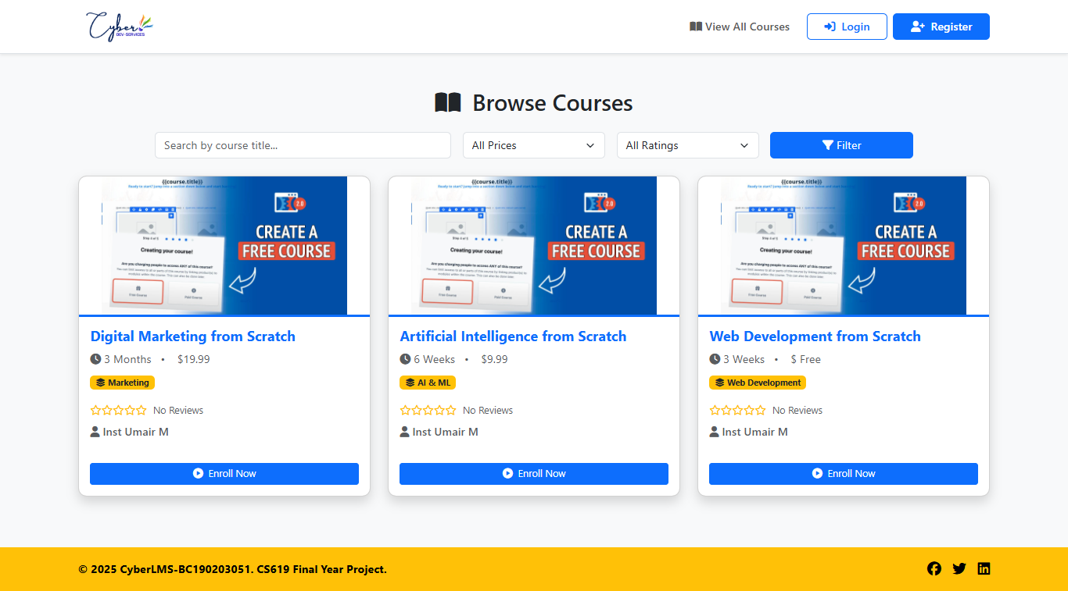
User-Interfaces
2025
GUI of Courses Page
Filter Courses by title, Price and Ratings
Courses Shown here real time
Pagination will show-up here if more than 6 Courses available
Footer Section

Slide 27
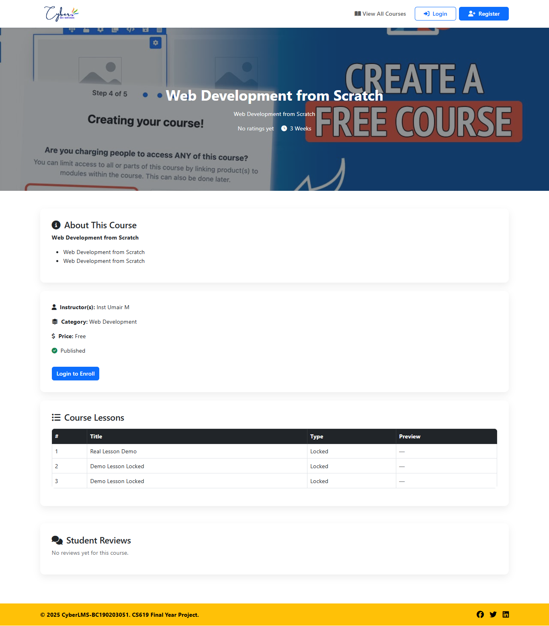
User-Interfaces
2025
Single Course Page GUI
Hero Section with overlay and Course title, short description, Reviews, & Duration
Long Description of the Course Goes here.
Enrollment, Category, price, & Instructor Name Goes here
All Lessons first one is always demo. With Preview and all other will be locked by default.

Slide 28
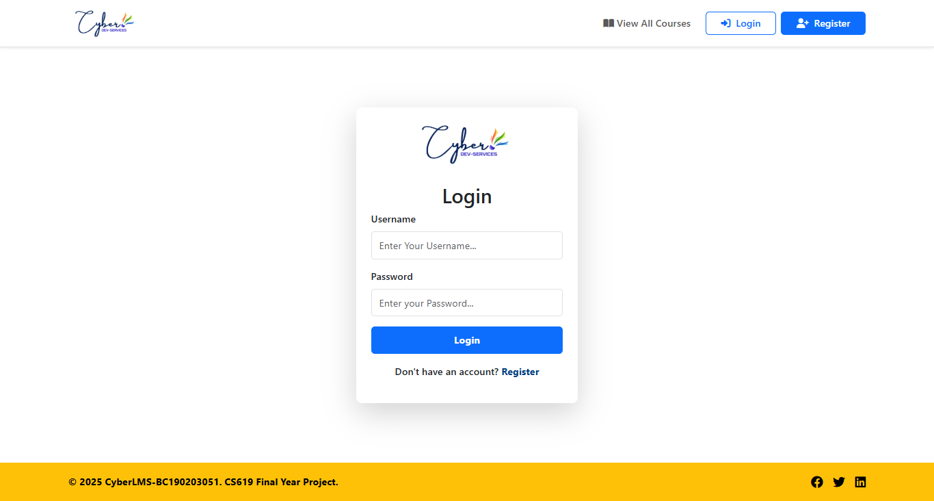
User-Interfaces
2025
Login page for All GUI
Student, Admin, Instructor Logins here with username and password. And auto redirected to their dashboard by their role-based access.

Slide 29
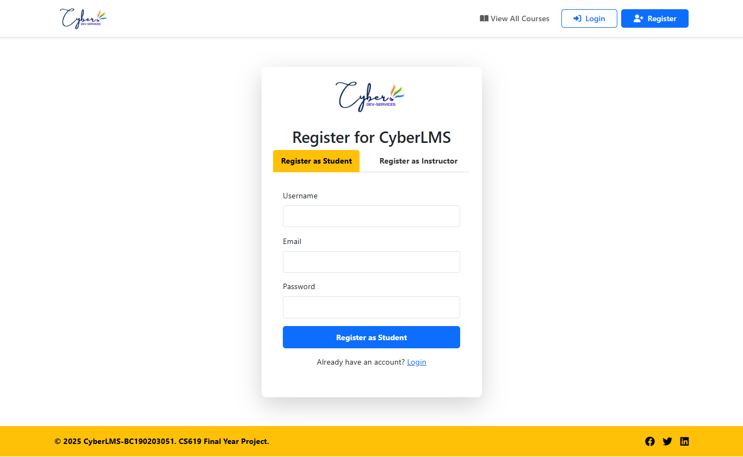
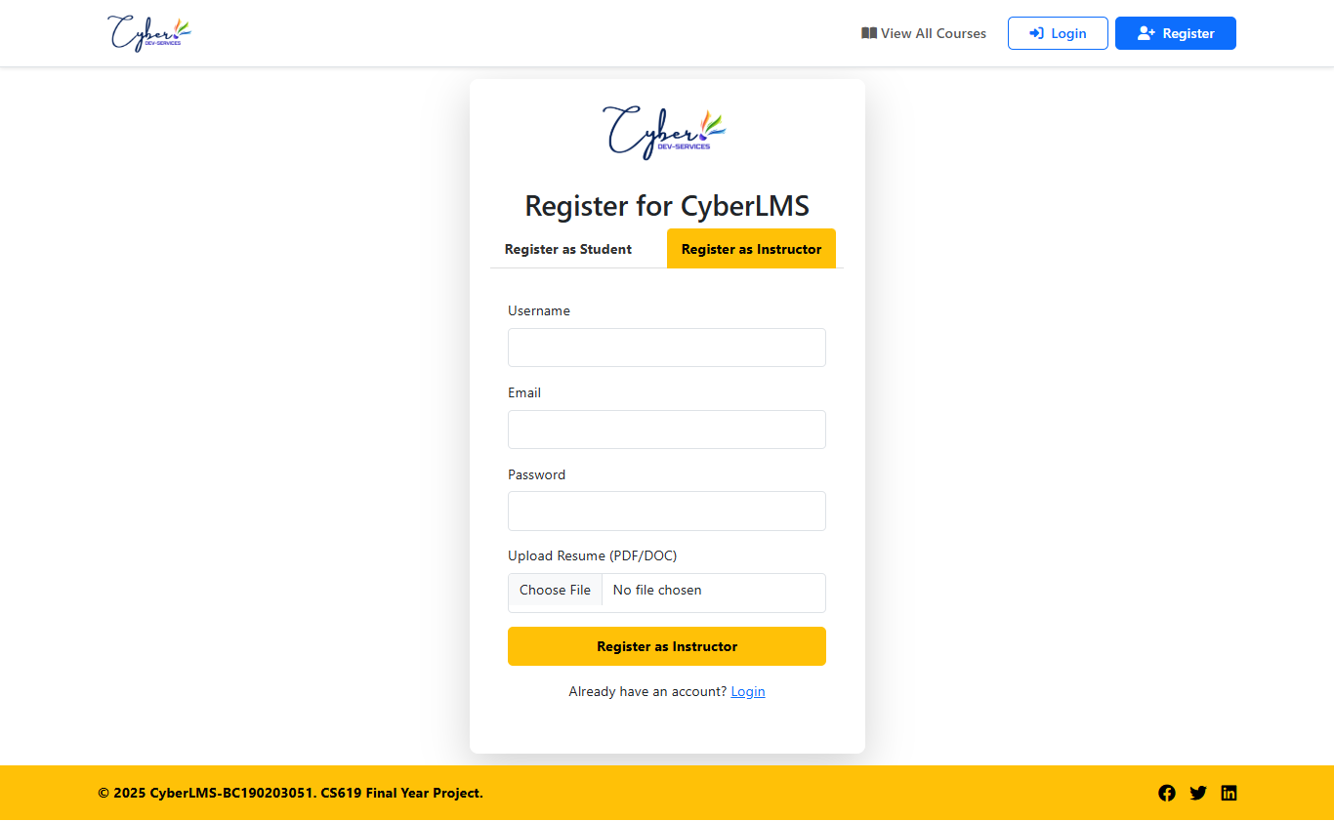
User-Interfaces
2025
Registration Page for Student & Instructor
Register as a student by username, email and password.
Register as an instructor by username, email, password, and resume upload.

Slide 30
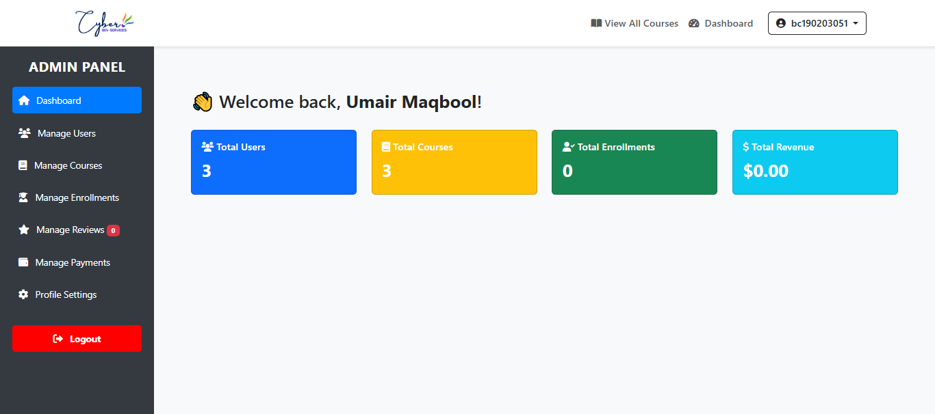
User-Interfaces
2025
Admin Dashboard GUI
Role Based Header Switching.
Admin sidebar to control all features of platform
Cards to show real time data about users, courses, enrollments, and revenue.

Slide 31
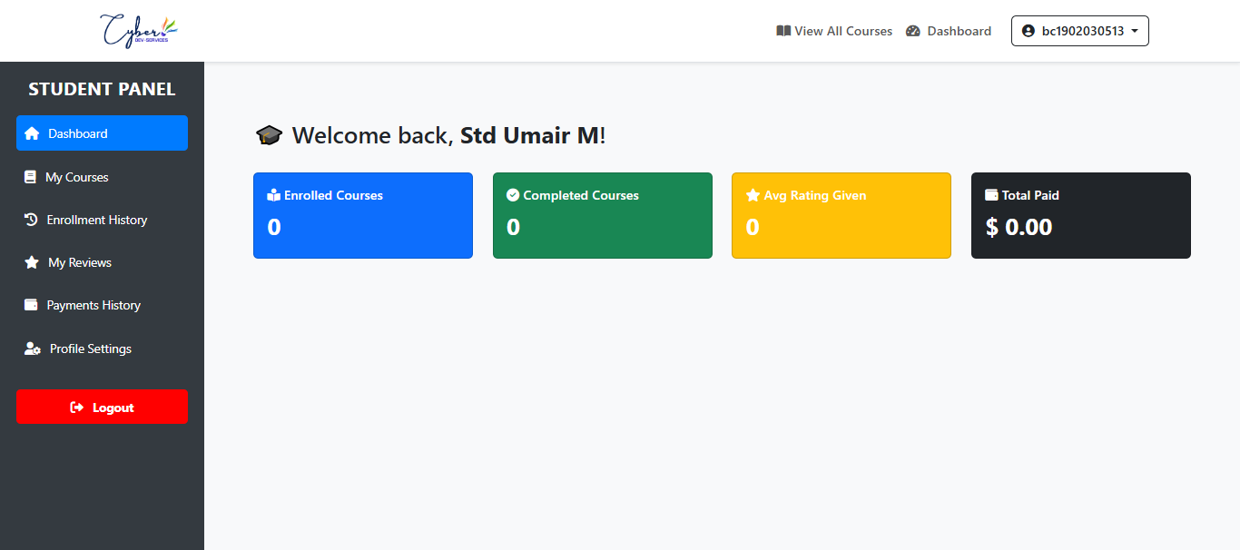
User-Interfaces
2025
Student Dashboard GUI
Role Based Header Switching.
student sidebar to control all features of platform
Cards to show real time data about enrollment, courses, ratings, and paid amount.

Slide 32
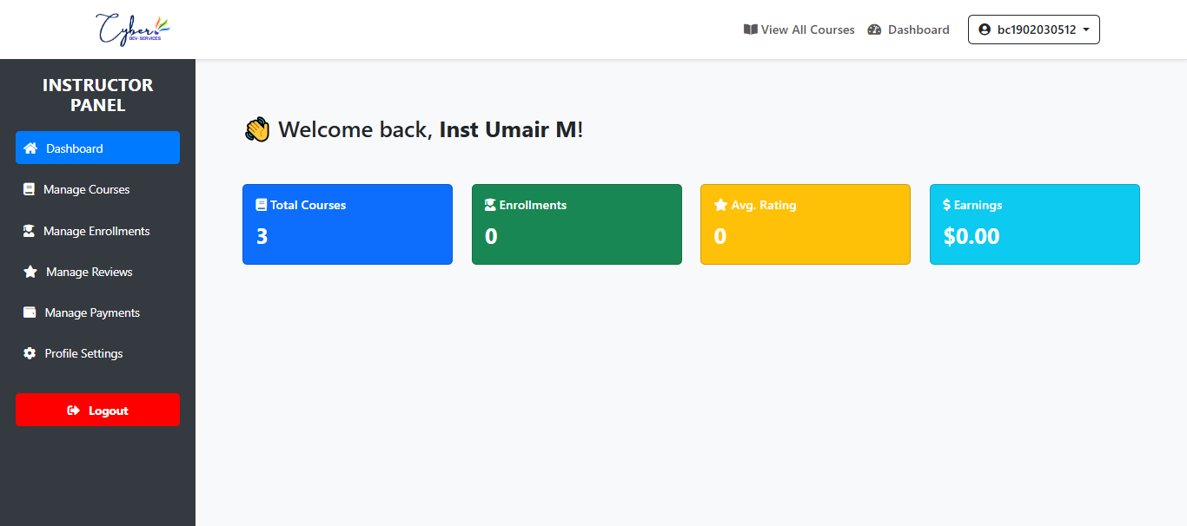
User-Interfaces
2025
Instructor Dashboard GUI
Role Based Header Switching.
Cards to show real time data about total enrollments, courses, ratings, and earned revenue.
instructor sidebar to control all features of platform

Slide 33
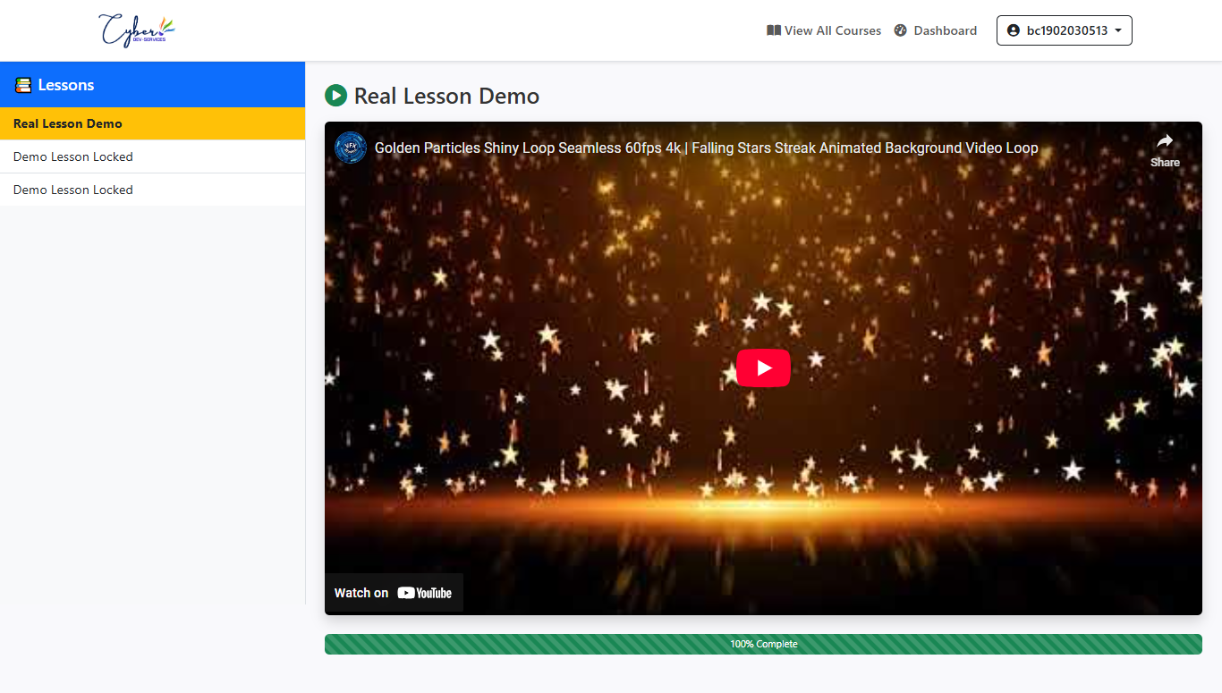
User-Interfaces
2025
Learning Dashboard GUI
Role Based Header Switching for real time and easy navigations to other pages.
All Lesson will showup here to navigate and switch between lessons.
Real time progress update of the course

Slide 34
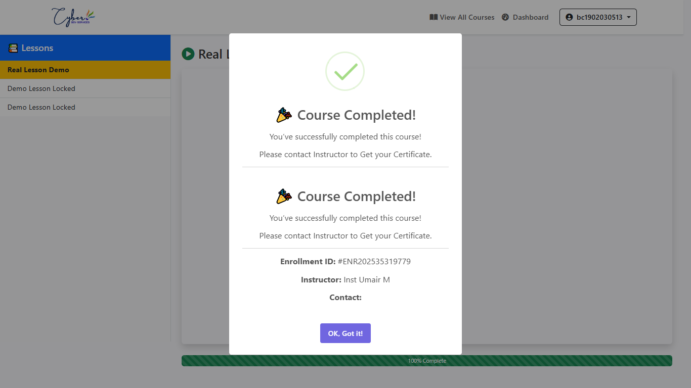
User-Interfaces
2025
After Course Completion GUI
After successful course completion student can also watch and view course content for lifetime and it just shows up this notification to contact instructor to get certificates.

Slide 35







Languages & Tools Used
2025
HTML is used for Frontend User Interface & structure in this project.
Bootstrap & CSS is used for styling the components in this project using external links and inline CSS.
JavaScript is used for live search manipulation and other interactions in this project.
PHP is used for Backend
Development in this project.
Visual Studio code is used for the complete project building and various extensions also used.
SQL is used for server side and as a database language.

Slide 36
THANK YOU!
2025
Umair Maqbool – BC190203051

